Slide 1
HYPERTENSION PREDICT
By Rachel Nderitu & Ashley Muiru.

Slide 2
Table of contents
01
02
03
04
05
06
Problem Definition
Design
Development
Testing
Deployment
Potential Impact

Slide 3

01
Problem Definition

Slide 4

Introduction
Hypertension, also known as high blood pressure, is one of the hardest diseases to get an early diagnosis for. It rarely has any distinct symptoms, and if there are any, they're not flagged until it's too late to prevent it.
Being one of the major causes of cardiovascular diseases, it is not a disease to be ignored. Hence why early detection is the best solution to preventing heart complications and improve patients suffering from it significantly.

Slide 5

OUR OBJECTIVES
Our objective, therefore, is to develop a prediction model that's AI-driven. The work of this model would be to use patient data (medical history, age, etc.) to predict whether a patient is a strong candidate for hypertension or not.
The idea is to platform this on a web-based interface that can then be used by medical personnel to enter patient data and access their patients’ diagnoses. Thereafter, the doctor can be able to recommend a change in lifestyle and/or a referral to a nutritionist.

Slide 6
PROJECT DESIGN
System Architecture
Data Collection | Hypertension dataset from Kaggle
Data Preprocessing | Data Cleaning & Normalization
Model Training | Used 5 models: SVM, Random Forest, Gradient Boosting, etc.
Model Evaluation | Test Accuracy, Recall, F1 Score, etc.
Deployment | User-friendly Interface (built a WIX website)
Overview
To the left is a brief overview of our project design, essentially the steps we took to achieve the end-goal of our project.
To Note
We did all our code in Google Colab using Python.
01
For the website, it’s not actually functioning; it’s supposed to be the idea of the website.
02

Slide 7
DEVELOPMENT & TESTING
Data Collection
Data Preprocessing
We loaded and prepared the hypertension dataset from Kaggle, which includes patients’ clinical measurements; key features such as age, sex, thalassemia, Fasting sugar, chest pain level, Blood pressure readings, etc.
Data cleaning has been performed by removing any missing values by using the SimpleImputer with the mean strategy from the Kaggle dataset.
Normalization has also been achieved by standardizing the features using StandardScaler to ensure consistency in our data.

Slide 8

Model Training & Evaluation
After cleaning the dataset, we created and trained our chosen models (Logistic Regression, Decision Tree, Gradient Boosting, SVM & Random Forest)
Evaluation was then done using the metrics Accuracy, Precision, Recall, and F1 Score. Our results are in the next slide.

Slide 9
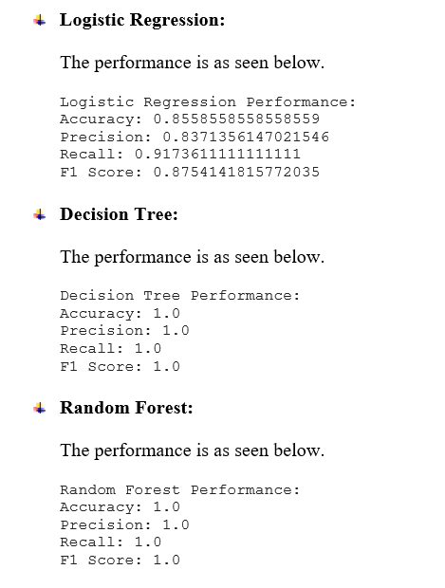
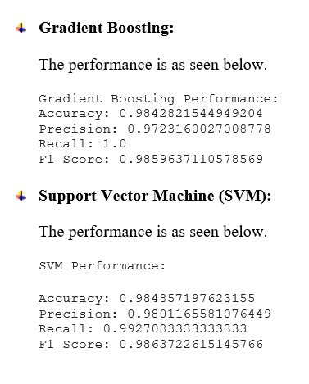
Model Training & Evaluation Results

Slide 10
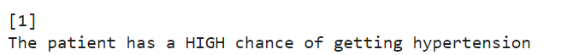
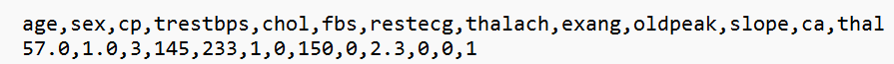
DEPLOYMENT: Phase-Colab
Colab Notebook
Predictive System
In our Notebook, we have interactive questions that are shown on the next slide. In this section, you have the option of entering values to find out whether someone has a high chance of getting hypertension or not.
Remember to enter as shown below:
After entering the data, run the very last cell of the Notebook to get the prediction of whether you have a high chance of getting HBP or not, as shown in the image below:

Slide 11
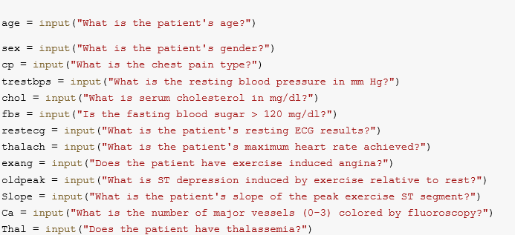
DEPLOYMENT: Phase-Colab
On our Colab Notebook, we have the following questions that are to be asked by doctors:

Slide 12
DEPLOYMENT: Phase-WIX
Home
Form
Treatment
Our mock website has 3 pages starting us off with the Home page(which is supposed to be the Login page). This will be where medical practitioners can login with their credentials to access the second page.
The Form page; where medical personnel can enter their patients’ medical data and submit the form so that the AI prediction system in the backend can work on giving the prediction from the data given. In our website form, however, not all the variables are included.
And lastly, the Treatment page. Since the model prediction is taking place in the backend, after submitting the form, the results will appear here as either a High chance of HBP or Low. If it’s High, then there will be a final section where the doctor can enter the patients’ contact info to send them recommended treatment plans, if the patients wish.

Slide 13
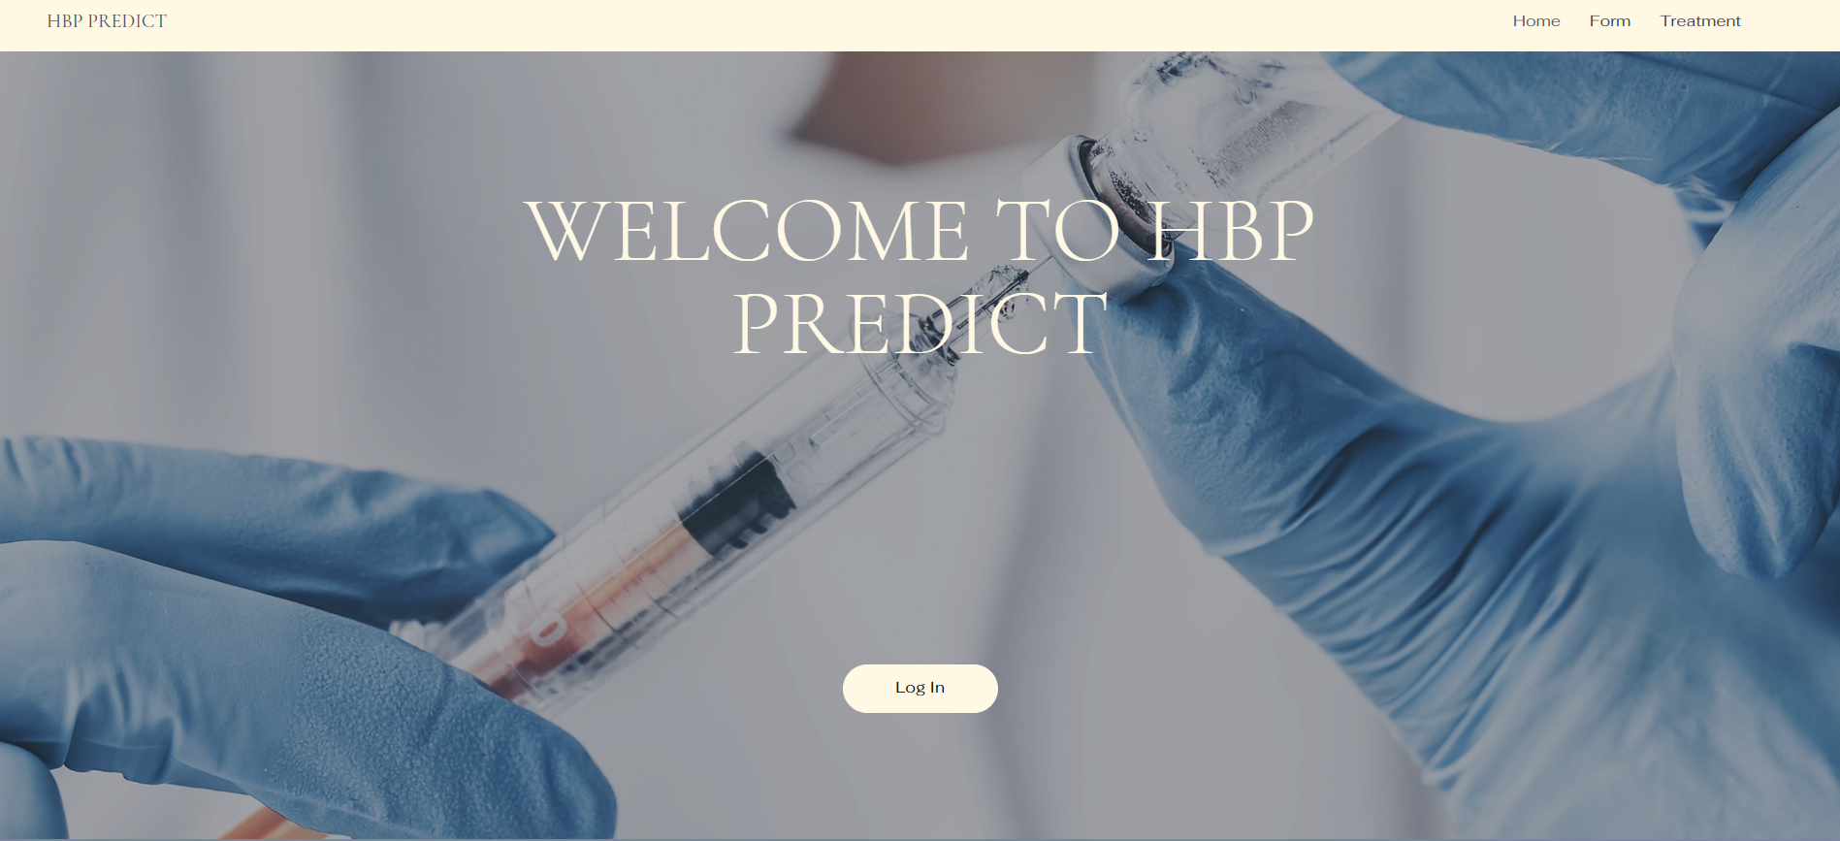
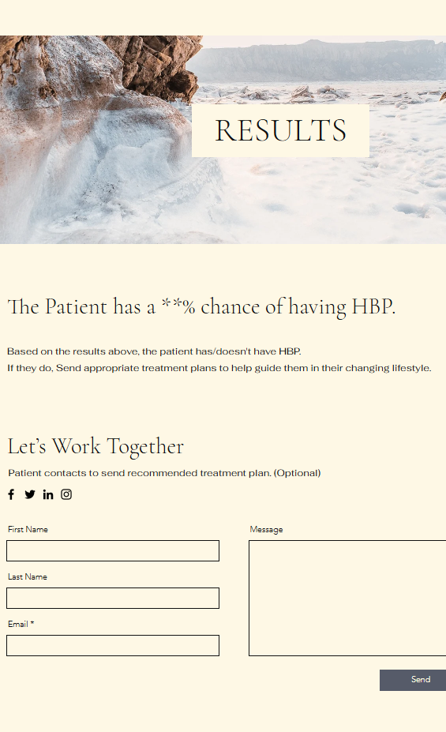
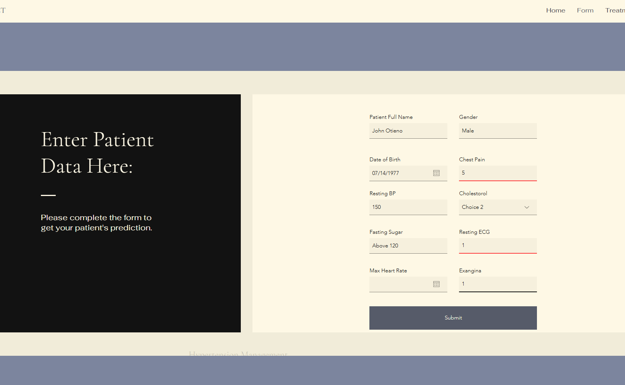
WIX Website
These are just photos from the website to give you a sense of how the web-interface is supposed to look like.

Slide 14

06
Potential Impact

Slide 15
POTENTIAL IMPACT
Early Detection & Prevention
Improved Patient Outcomes
By providing doctors with a tool to predict the likelihood of hypertension in patients, our web interface can facilitate early detection. This allows for timely intervention, which can prevent the onset of more severe cardiovascular diseases.
Our website can help doctors tailor their treatment plans based on the predictive insights provided.
Personalized treatment can improve patient adherence to medication and lifestyle changes, leading to better health outcomes.
Education and Awareness
Supporting Health Policies
The website can also be an educational tool for patients, helping them understand their risk factors and the importance of managing their health proactively. Increased awareness can lead to better health-seeking behaviors and lifestyle changes.
Lastly, the website aligns with global health initiatives (Target 3.4) focused on non-communicable diseases (NCDs) management and prevention. By contributing to the reduction of hypertension, our tool would support the broader goals of reducing NCDs globally.

Slide 16
Thanks!

